Slide 1

Fighter Analysis
Predicting Match Winners

Slide 2
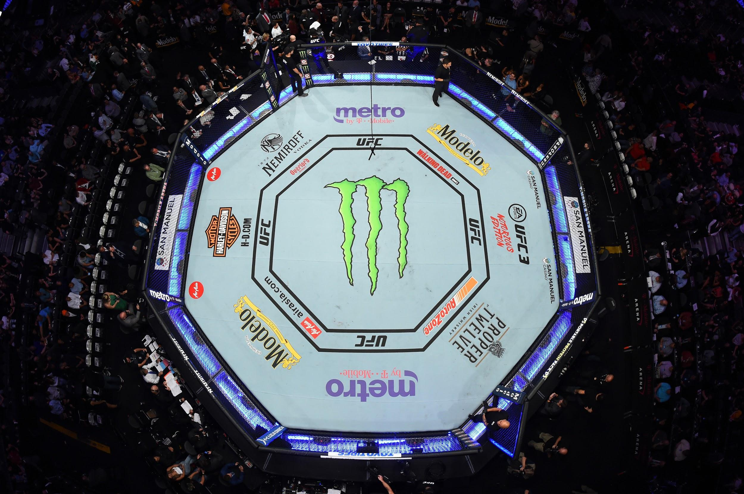
Overview of Project
Our group members are UFC and MMA fans and would like to use the skills we learned in the course to examine fighting techniques to determine which have the most effect the win in a match.

Slide 3
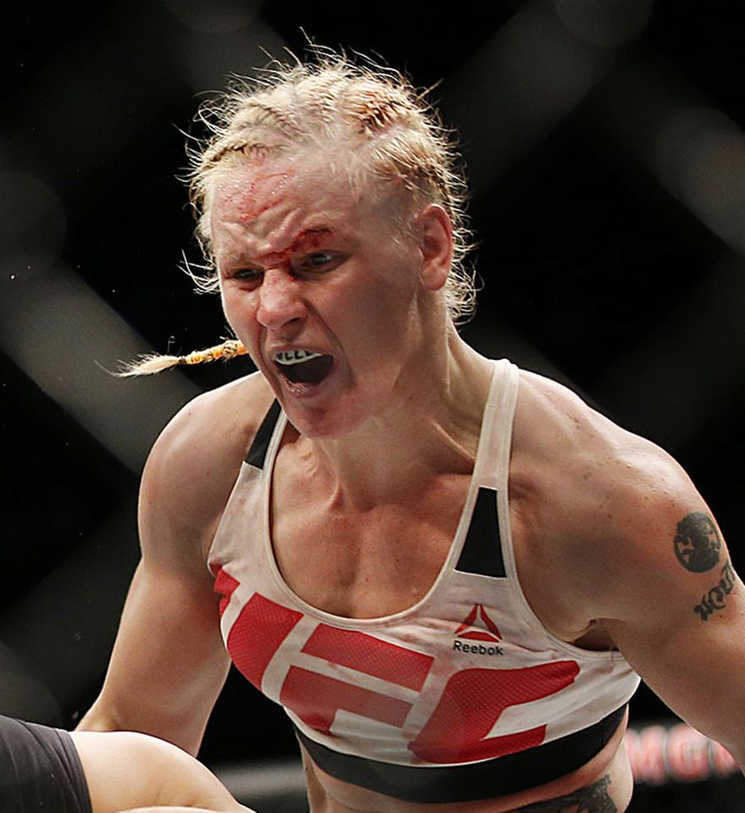
Mixed martial arts (MMA) is a full-contact combat sport based on striking, grappling and ground fighting, incorporating techniques from various combat sports and martial arts from around the world.
Ultimate Fighting Championship (UFC) is a Las Vegas based promotion company that has revolutionized the fighting business since 1993. UFC features some of the highest-level fighters in the sport on its roster and produces events worldwide that showcase twelve weight divisions (eight men's divisions and four women's divisions). As of 2020, the UFC has held over 500 events and grown into a globally popular multi-billion-dollar enterprise.
Notes:
Oybek’s Fav: Name, Bio, Record, Stance, Signature Move(s)

Slide 4
Purpose of Analysis
Using a Kaggle dataset containing various attributes of UFC fighter stats, fighting techniques and body metrics, we will predict winning fighters with machine learning.
Our CSV file is small (23 columns and 8.990 rows) but complete as it contains roughly every match under the UFC umbrella.
A Git Hub repository was created for the analysis so everyone in the group can contribute and review information.
The group will meet twice a week during our scheduled class sessions on Zoom to work on the project and use our team Slack channel to communicate during the week.

Slide 5
Role Distribution
After establishing the communication structure, we created the foundation for our UFC fighter analysis project by defining roles that play to our individual strengths.
 | Segment 1 | Segment 2 | Segment 3 | Segment 4
Square | Mohammed | Alexandra | Mohammed
Triangle | Alexandra | Mohammed | Felicia
Circle | Oybek | Oybek | Oybek
X | Felicia | Felicia | Alexandra

Slide 6
Results
Segment 1 Pre-Processing the Data
Our CSV file is small (23 columns and 8,990 rows) but complete
To clean the data and make it appropriate for machine learning we:
Renamed the Win Column to Win or Lose to better predict wins and losses with the model and for easier interpretation.
Dropped unnecessary columns and NaN rows to further clean our data.
We then used OneHotEncoder to encode and read the data into the model.
Segment 2 Training the Model and Integrating the Database
To make sure we used the best entities for our SQL database, we mapped it with an Entity Relationship Diagram.
We used StandardScalar to train and test our data and selected Random Forest to model our data

Slide 7
Results
Segment 3 Refining and Visualizing the Data
We performed an exploratory analysis and established a baseline accuracy score of 64%
We decided to use feature selection to find the best attributes to explain the relationship between a fighter’s characteristics and winning matches
A linear regression model helped us identify which variables were most significant.
This removed the noise in our model but the accuracy didn’t improve.
We were able to improve the false negatives and positives - making our model more precise
However, we didn’t have enough data to explain the variance.
Notes:
Independent variables:gender, class, weight, reach, height or odds
Target Variable: winning matches
Random Forest is our preferred modeling tool because it:
o Runs efficiently on large data sets
o Works against overfitting
Can be used to rank input variables

Slide 8
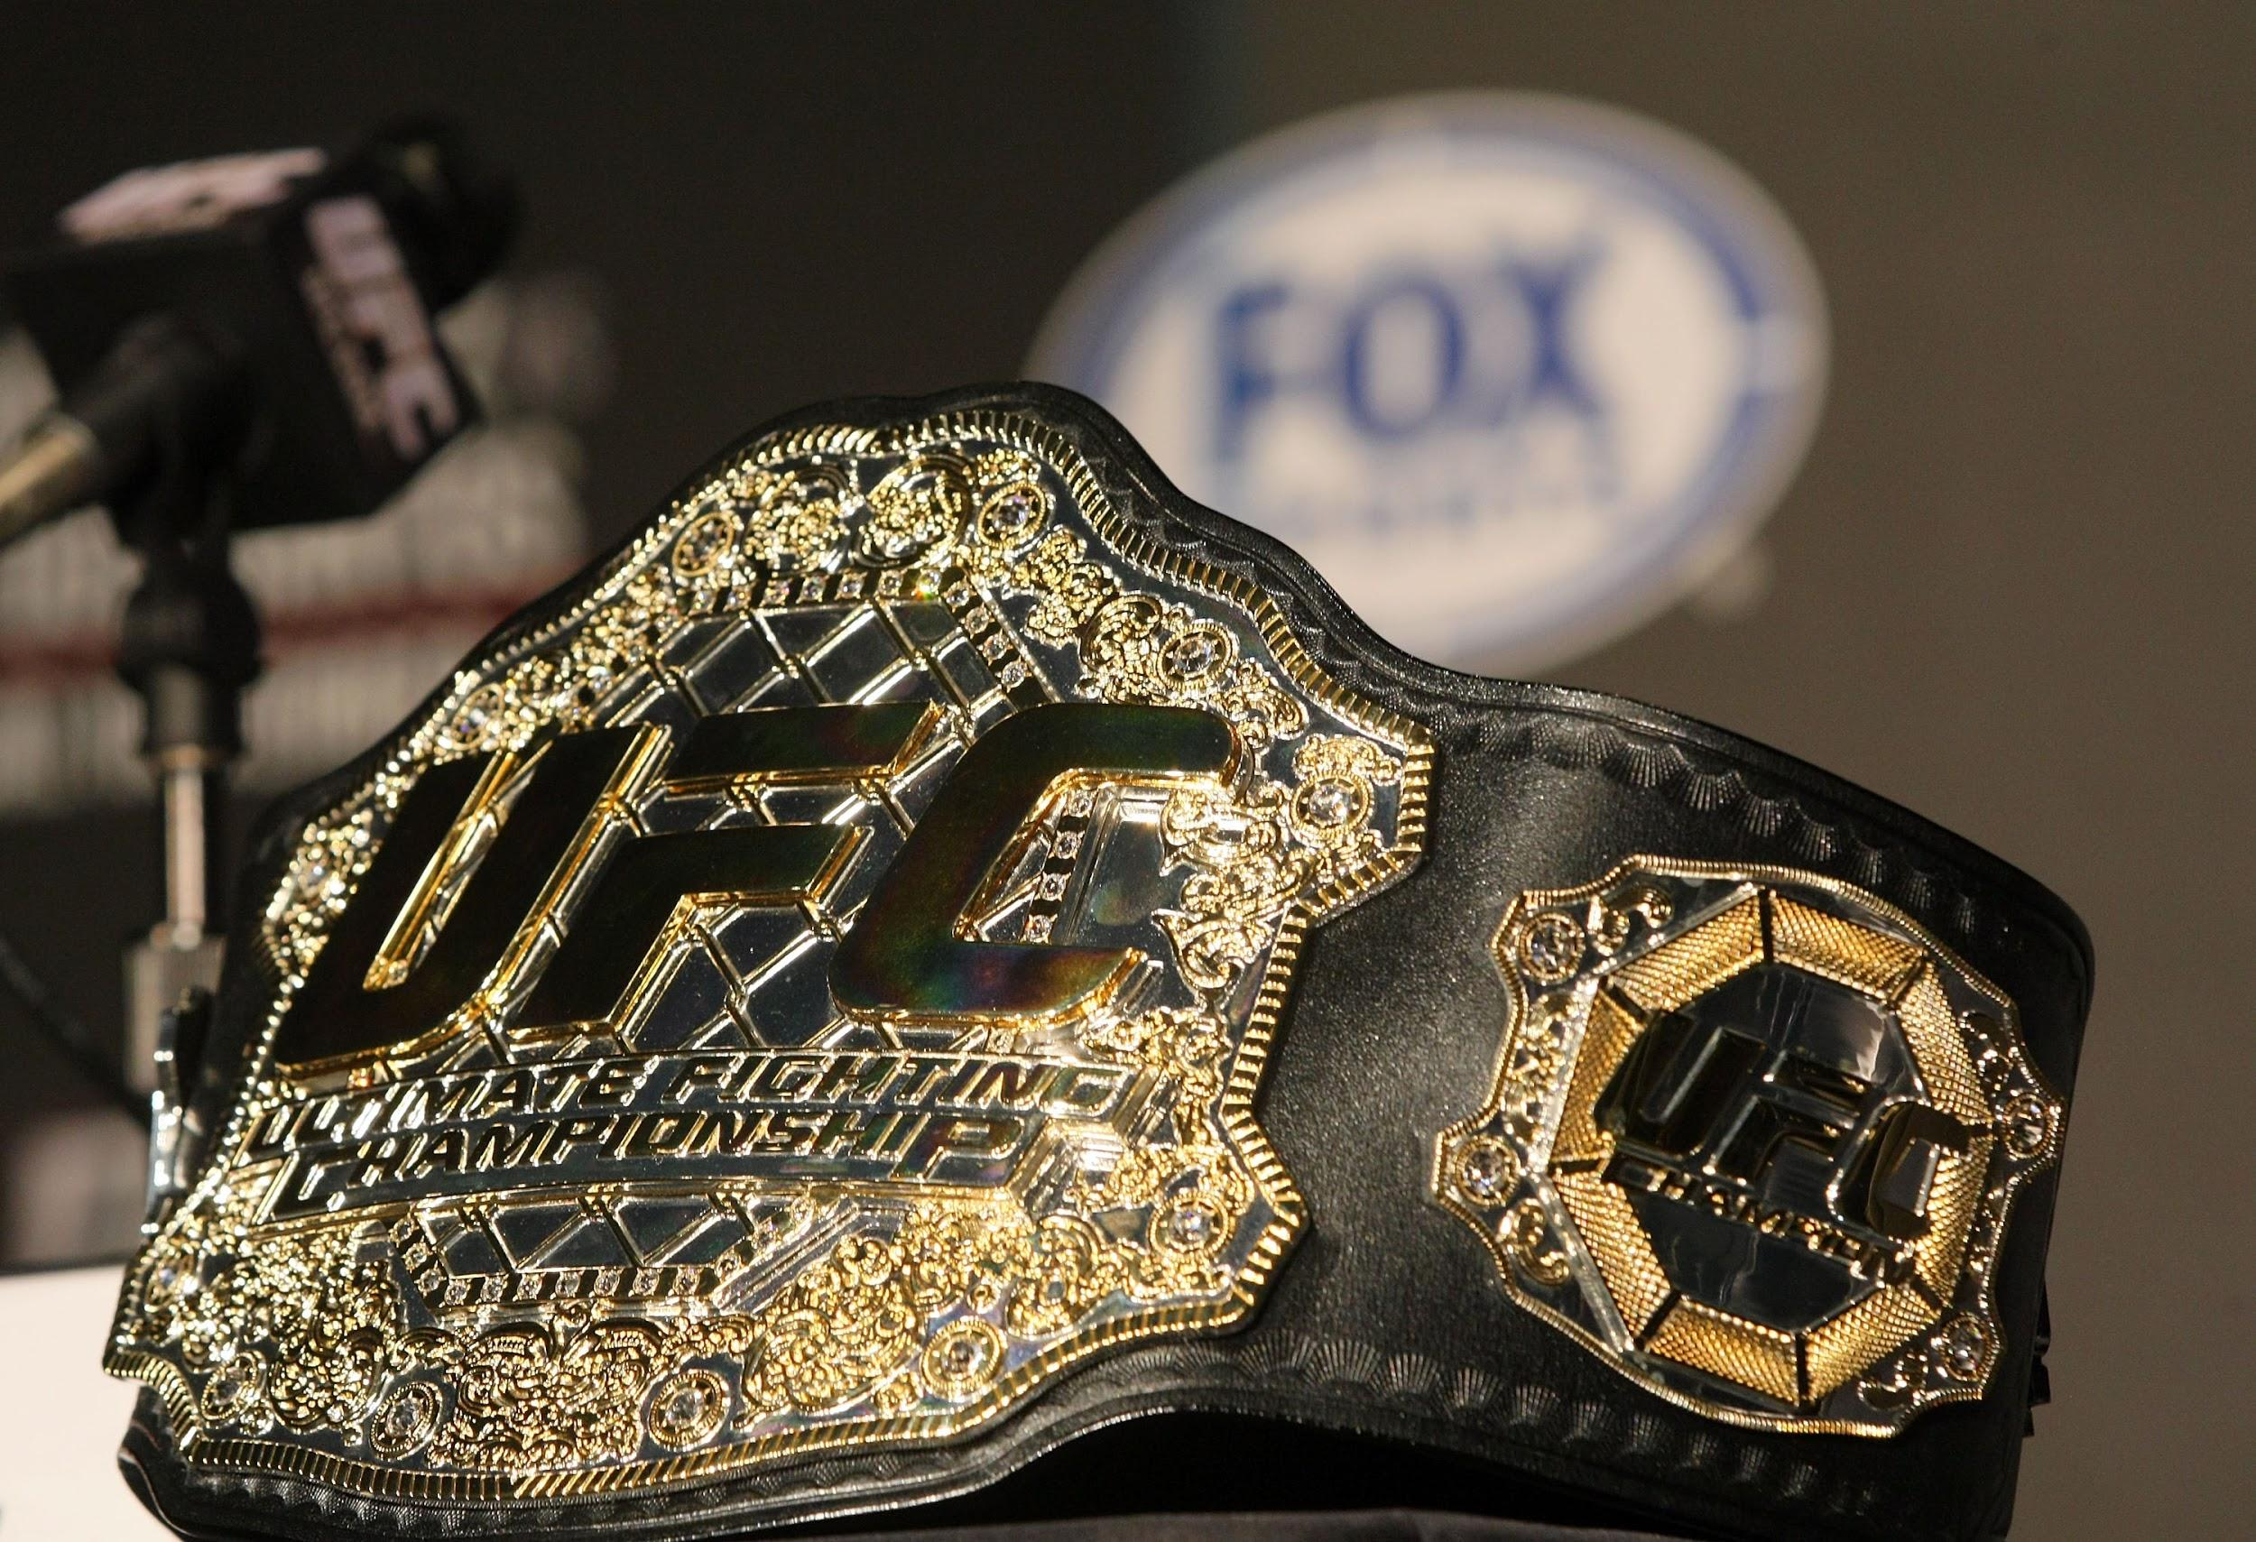
Summary
We created the foundation for our UFC fighter analysis project by defining roles that play to our individual strengths and establishing the communication structure. We preprocessed our data for easier encoding and modeling.
We performed an exploratory analysis to establish a baseline accuracy score, created a database and used a linear regression to fine tune our model’s accuracy.
While we were able to remove the noise and improve the model’s precision, we didn’t have enough data to explain the variance so we used our dashboard to visualize interesting observations from the dataset such as countries with the most winning fighters, winning stances and winning finishes.
Notes:
What makes a champion? We don’t know

Slide 9
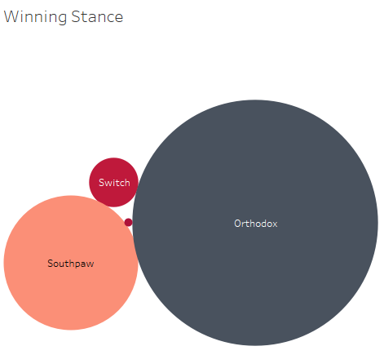
Dashboard/ Visualization
Orthodox Stance: The fighter places their left foot farther in front of the right foot, thus having their weaker side closer to the opponent
Southpaw Stance: The fighter has their right hand and right foot forward. It is the normal stance for a left-handed fighter.
Switch: Fighting in both stances
Notes:
This makes sense because most people are right-handed.
Switch is one of the best ways to completely surprise your opponent and catch them off guard.

Slide 10
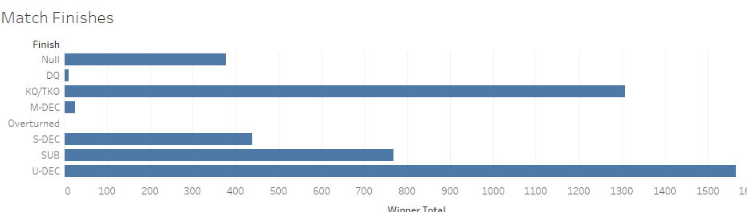
Dashboard/ Visualization
Knockout: Any strike (whether it be a punch, kick, elbow, knee, or even a slam) or a combination of strikes from one fighter that leaves his/her opponent unable to continue. Separation of consciousness isn’t as necessary for KOs as much as it is a fighter being unable to physically defend himself or herself.
Technical Knockout: Refers to a fighter being overwhelmed by the attack of his opponent and is deemed to be “unintelligently defending himself or herself.” A third party must intervene to stop the match and prevent any further damage to the defeated fighter.
Notes:
Most matches are won by Unanimous Decision or when all of three judges score the fight in favor of the same fighter.
Followed by Knockouts and Technical Knockouts.
Unlike boxing and kickboxing KOs, there is no such thing as counting out a downed opponent in MMA, since fighters can take the fight to the ground. And, in fact, knockouts can occur on the ground, whether it be a fight-ending elbow or punch from the top fighter or the always crazy upkick from the bottom fighter.
There are different types of TKOs in MMA.
Referee stoppage: The referee steps in and stops a fight when a fighter is not defending himself or herself from the opponent’s striking, preventing further damage.
Corner stoppage: Also referred to as “throwing in the towel,” a fighter’s cornerman stops the fight for his/her own fighter’s sake. Alternatively, a fighter quits the fight between rounds.
Doctor’s stoppage: The ringside physician elects to stop the fight due to excessive bleeding from a cut or another physical injury
Submission due to strikes (UFC only): A fighter submits while being overwhelmed with strikes. While most MMA promotions consider this a submission, it is ruled a TKO in the UFC.

